Slide 1
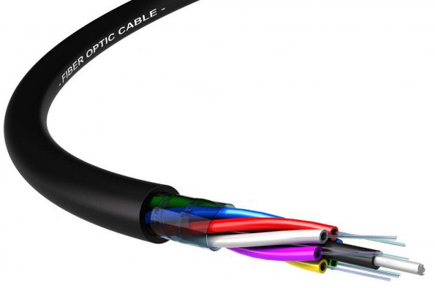

MICROTEACHING PENGGUNAAN PERALATAN FO
SMK PLUS PELITA NUSANTARA BOGOR

Slide 2





Page -
1
PENGANTAR
MICROTEACHING PERALATAN FO
Page - 2
2

Slide 3
Thank you for using www.freepdfconvert.com service!
Only two pages are converted. Please Sign Up to convert all pages.
https://www.freepdfconvert.com/membership

